Slide 1


INTERNSHIP PRESENTATION
Carried out by
HARIPRIYA R
4VV21EC046
ASIC DESIGN – RTL TO GDS
Internal Guide
Dr.Chaithanya DJ
Assistant Professor
Dept. of ECE
External Guide
CHANDHAN H P
Vivartan Technologies
Department of Electronics and Communication Engineering
Vidyavardhaka College of Engineering, Mysuru
Dept. of ECE, VVCE, Mysuru
Internship Presentation
2024-25

Slide 2
Contents
Company details
Mission
Objectives
Introduction
Task Performed
Outcomes of Internship
Conclusion
Internship Certificate

Slide 3

Company details
Vivartan Technologies provides solutions to building System on Chips (SoC) which involves both Digital and Analog designs.
They focus on end-to-end services for IoT, Mobile and NextGen Automobiles.
They have experience in all major technology nodes and fabs including latest FinFETs up to 7nm. Teams have expertise in all the industry standard EDA tools.
Vivartan aims to tie up with engineering colleges and institutes and then deliver courses to bridge the gap between industry and the academia.

Slide 4
Company Details
Company name: Vivartan Technologies LLP.
Address: No. 732, 9th Cross, 5th Main, MC Layout,
Vijayanagar, Bengaluru - 560 040
Phone no: +91 988 671 6583
Email-address: vivartan.edu@gmail.com
Website: www.vivartan.com
Class of company: Private
Founder: Mr. Sunil Kumar H V
Founded: September - 2009
Company sub category: Non-govt company
Corporate services: Digital Design, Analog and Mixed Signal,
Foundation IPs, Digital Automation.
Collaborative partner: ATME College of Engineering, Mysuru.
Vidyavardhaka College of Engineering, Mysuru.
CHRIST (Deemed to be University), Bengaluru.

Slide 5
Company Mission
Design and deliver programs creating best quality, employable, industry ready professionals.
Create a robust model bridging Industry and Academia for a conscious engineering community.
Build scale model to enable the growing need for employable engineers.

Slide 6
Company Objectives
There main objective is to transform Learning space through Innovative, Holistic and Scalable methods of program design, deliver and technology at its best.
Main objectives of VIVARTAN:
Train students.
Connect students and companies.
Install fundamentals of VLSI.
Develop industry-ready skills.
Create quality, employable engineering professionals.

Slide 7
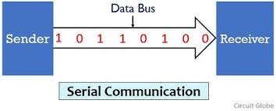
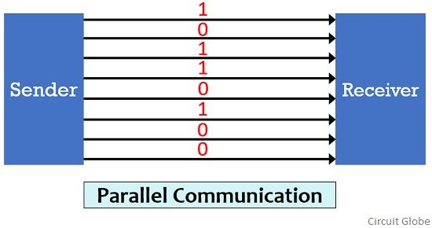
Introduction
Register Transfer Level(RTL)
RTL describes how data moves between registers in a circuit
RTL is implemented using hardware description languages (HDLs) like VHDL or Verilog
It is the starting point of the ASIC design flow before synthesis and physical design.
Communication Protocol

Slide 8
On-Chip Protocols :-
Used inside the SoC to connect processor, memory, and IP blocks.
Prioritize low latency and high bandwidth.
Examples : AXI protocol.
Peripheral Protocols :-
Used to communicate with external devices connected to the SoC.
Examples : SPI, I2C.

Slide 9
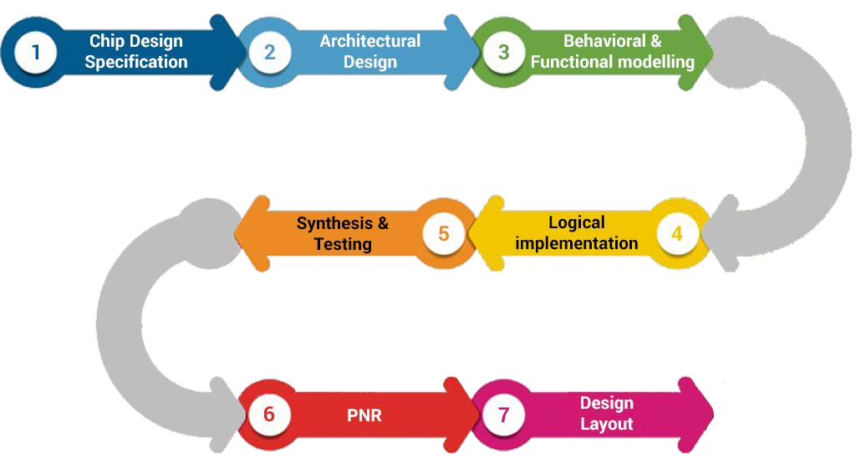
FSM (Finite State Machine)
FSM (Finite State Machine) helps to control the flow of operations in a chip.
It is used to design control logic at the RTL stage.
Makes it easy to handle sequential tasks like reading, writing.
Helps in building things like protocol controllers, ALU control unit.
ASIC Flow
Design in RTL: Write code (Verilog/VHDL) to describe how the chip should work.
Convert to Gates: Change the code into small building blocks.
Place and Connect: Position the gates on the chip and connect them.
Check Timing and Power: Make sure the chip runs at the right speed and uses power efficiently.
Create GDSII File: Finalize the chip layout for manufacturing.
ASIC Flow

Slide 10
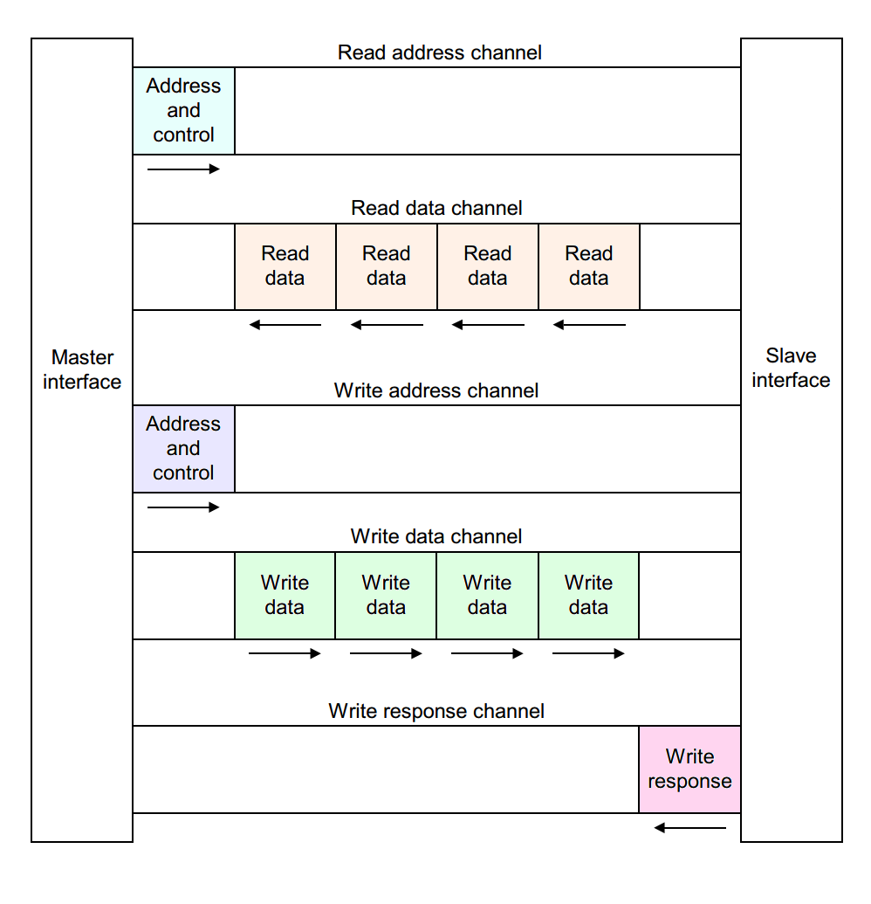
Advanced Extensible Interface (AXI)
Five independent channels.
Introduced in 2003.
Works on Master and Slave Configuration.
Designed for high-performance, high-frequency SoCs
Write Address Channel (AW) – Sends address for write.
Write Data Channel (W) – Sends data to be written.
Write Response Channel (B) – Sends write status from slave to master.
Read Address Channel (AR) – Sends address for read.
Read Data Channel (R) – Sends data from slave to master.

Slide 11
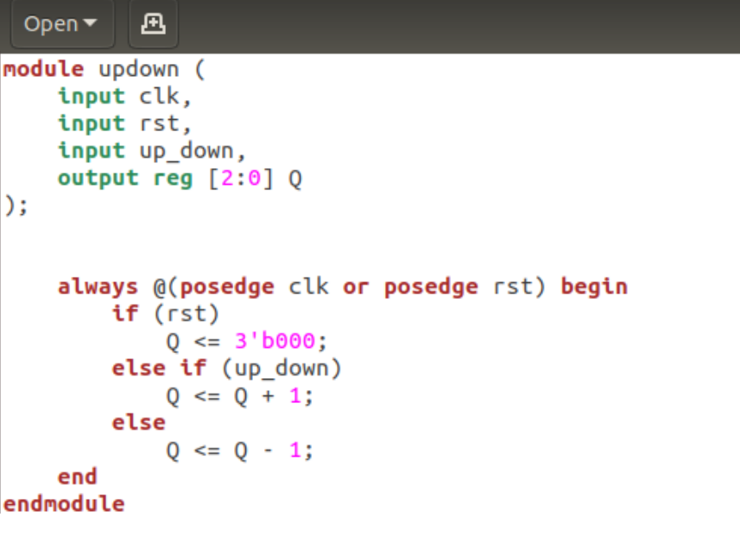
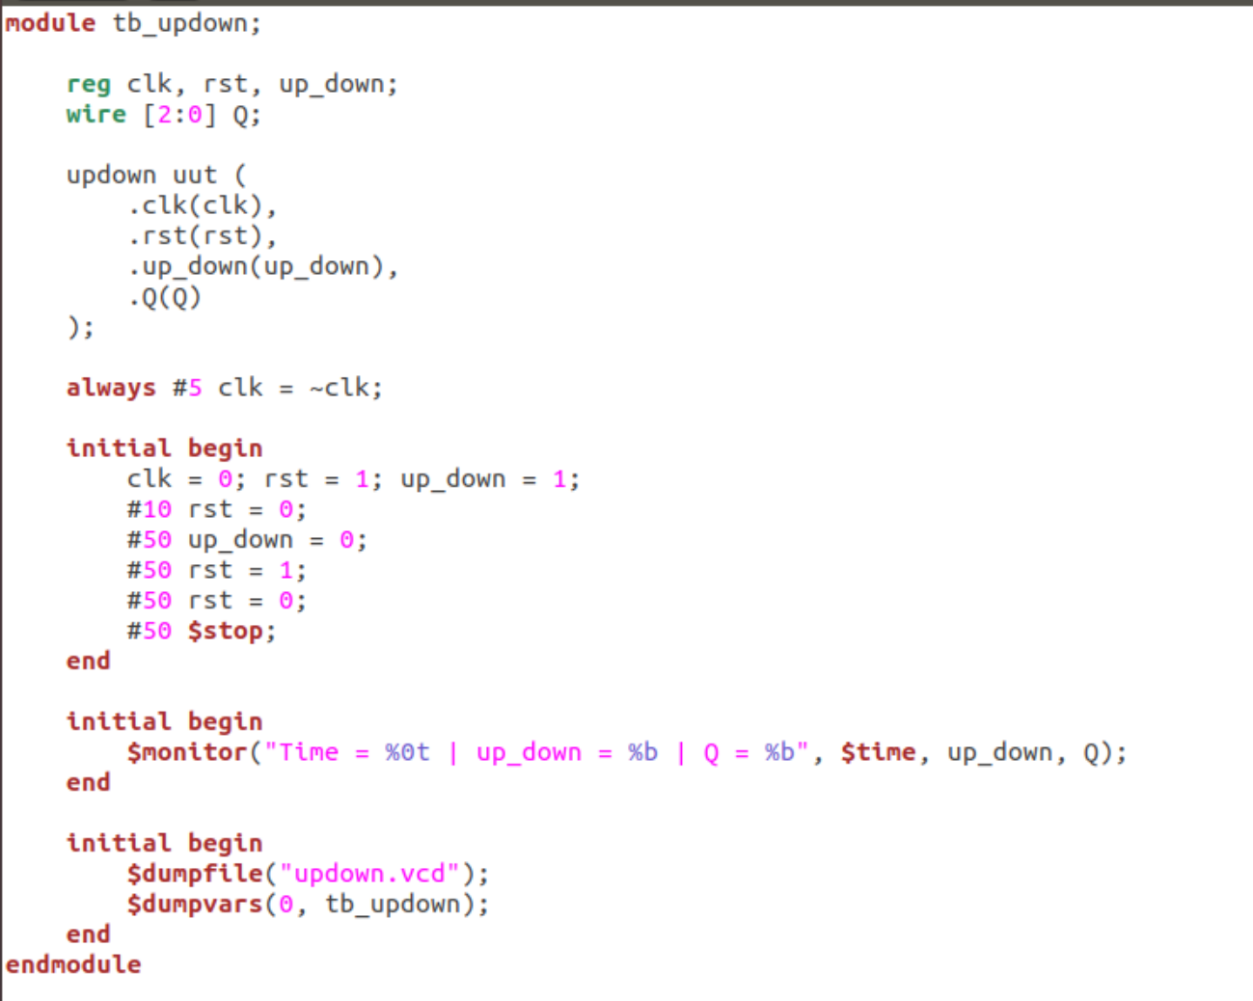
Task Performed
Task 1: UP-DOWN COUNTER.
Step1. Write code of the design along with test bench.
Step2. Select appropriate simulator and run options.
Step3. RUN Simulation.

Slide 12
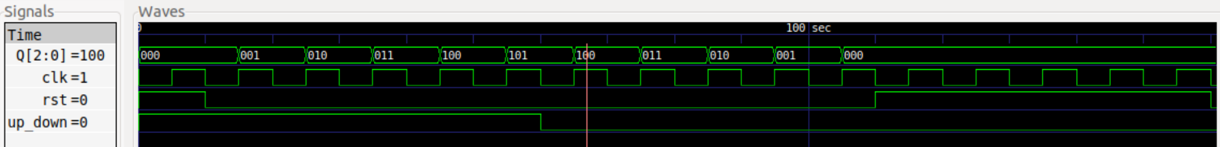
Output Waveform after simulating UP-DOWN COUNTER

Slide 13
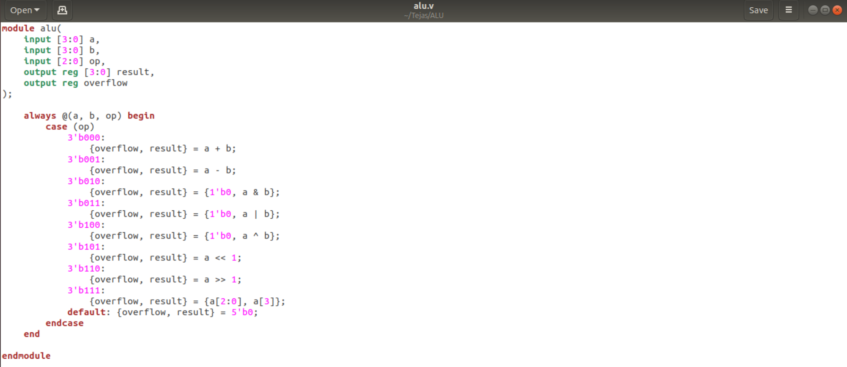
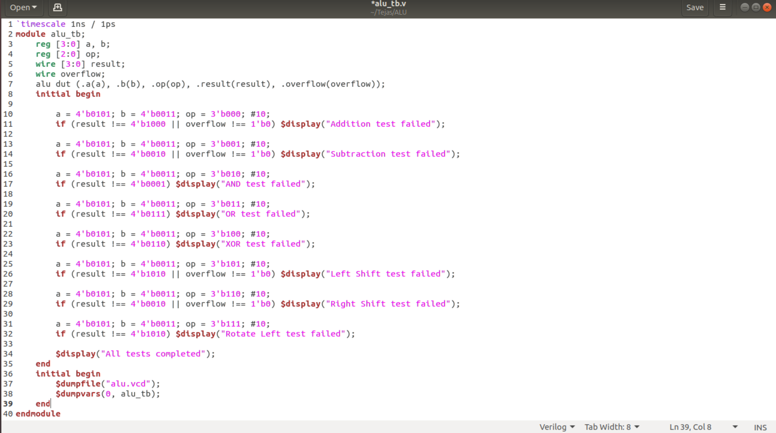
Task 2: ALU Design.
Step1. Write code of the design along with test bench.
Step2. Select appropriate simulator and run options.
Step3. RUN Simulation.

Slide 14
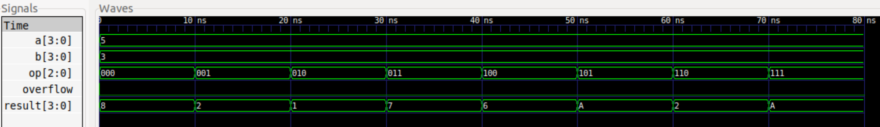
Output Waveform after simulating ALU Design

Slide 15
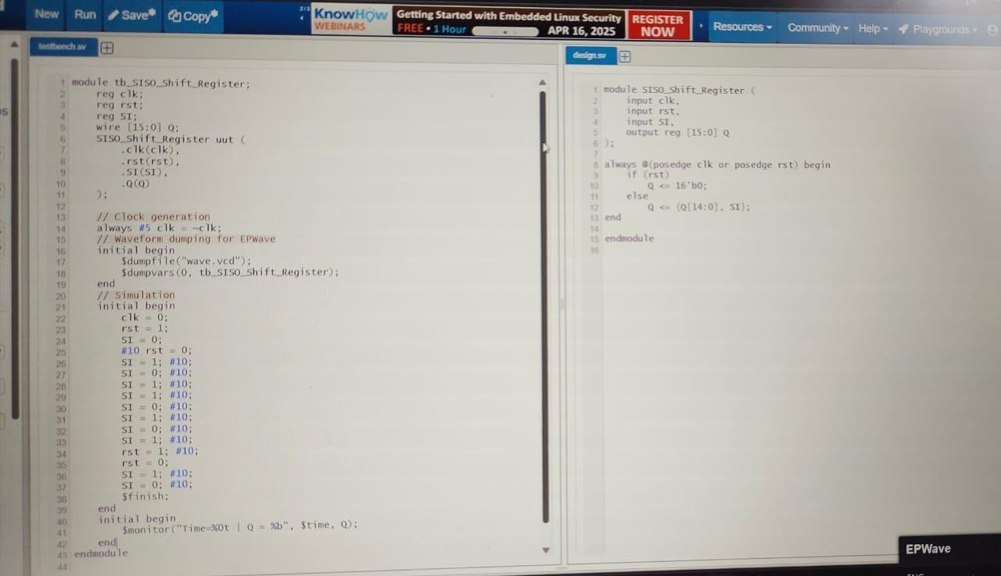
Task 3: 16 bit shift register SISO.
Step1. Write code of the design along with test bench.
Step2. Select appropriate simulator and run options.
Step3. RUN Simulation.

Slide 16
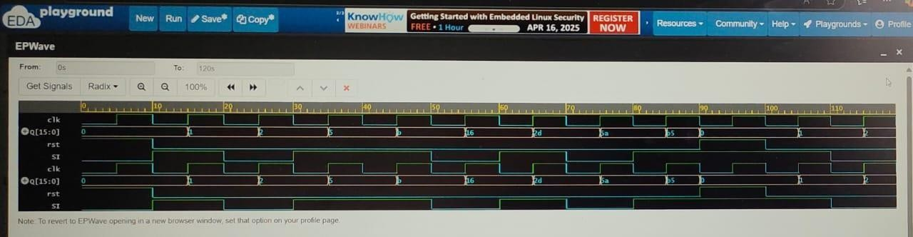
Output Waveform after simulating 16 bit shift register SISO.
.

Slide 17
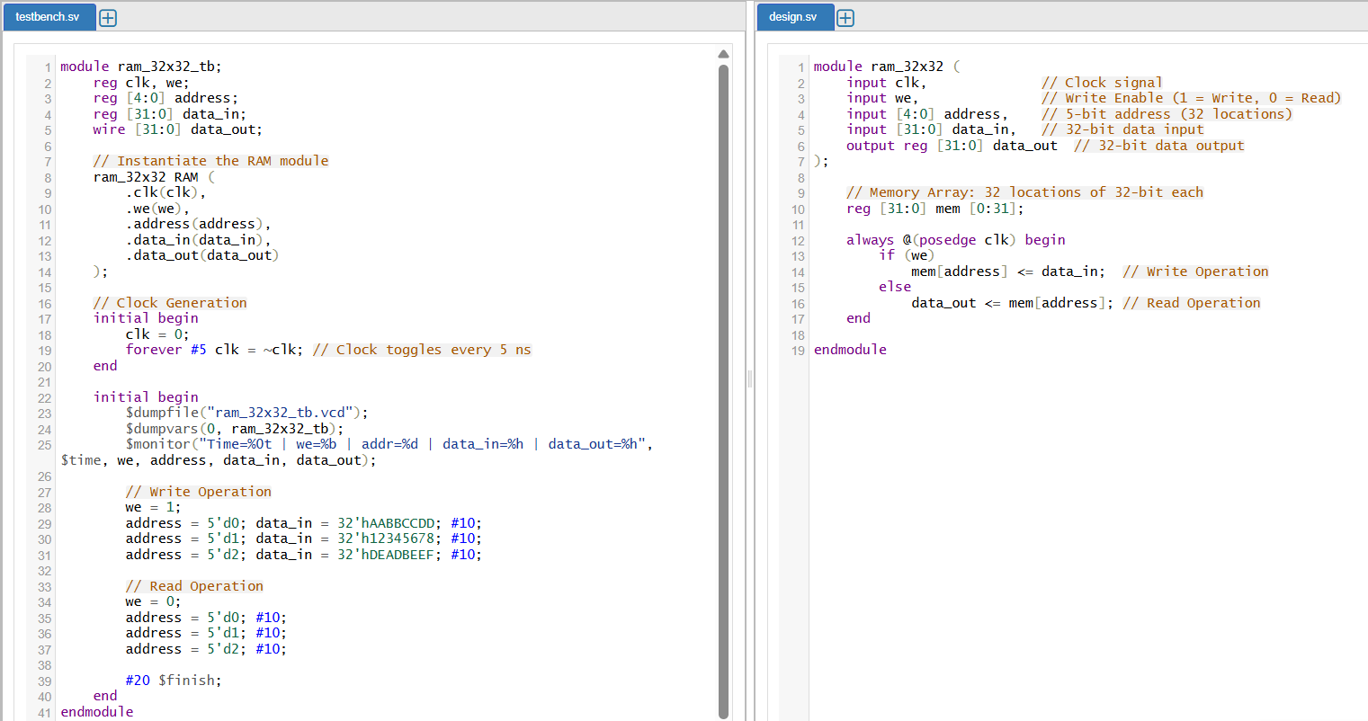
Task 4: 32 Bit RAM.
Step1. Write code of the design along with test bench.
Step2. Select appropriate simulator and run options.
Step3. RUN Simulation.

Slide 18
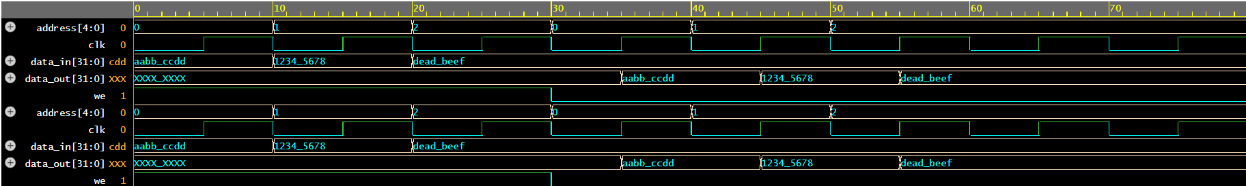
Output Waveform after simulating 32 Bit RAM .

Slide 19
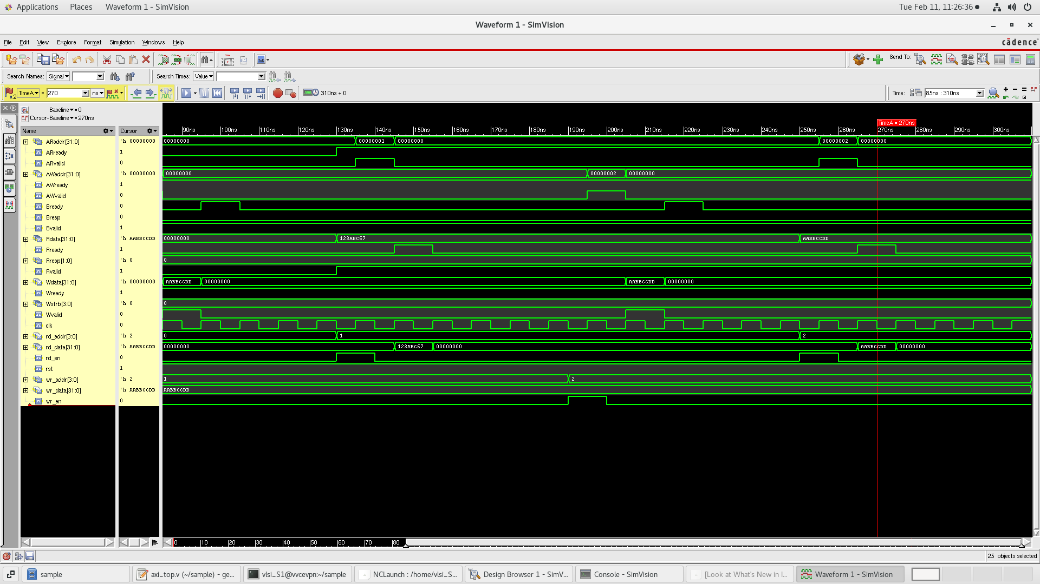
Task 5: AXI
Step1. Write code of the design along with test bench.
Step2. Select appropriate simulator and run options.
Step3. RUN Simulation.

Slide 20
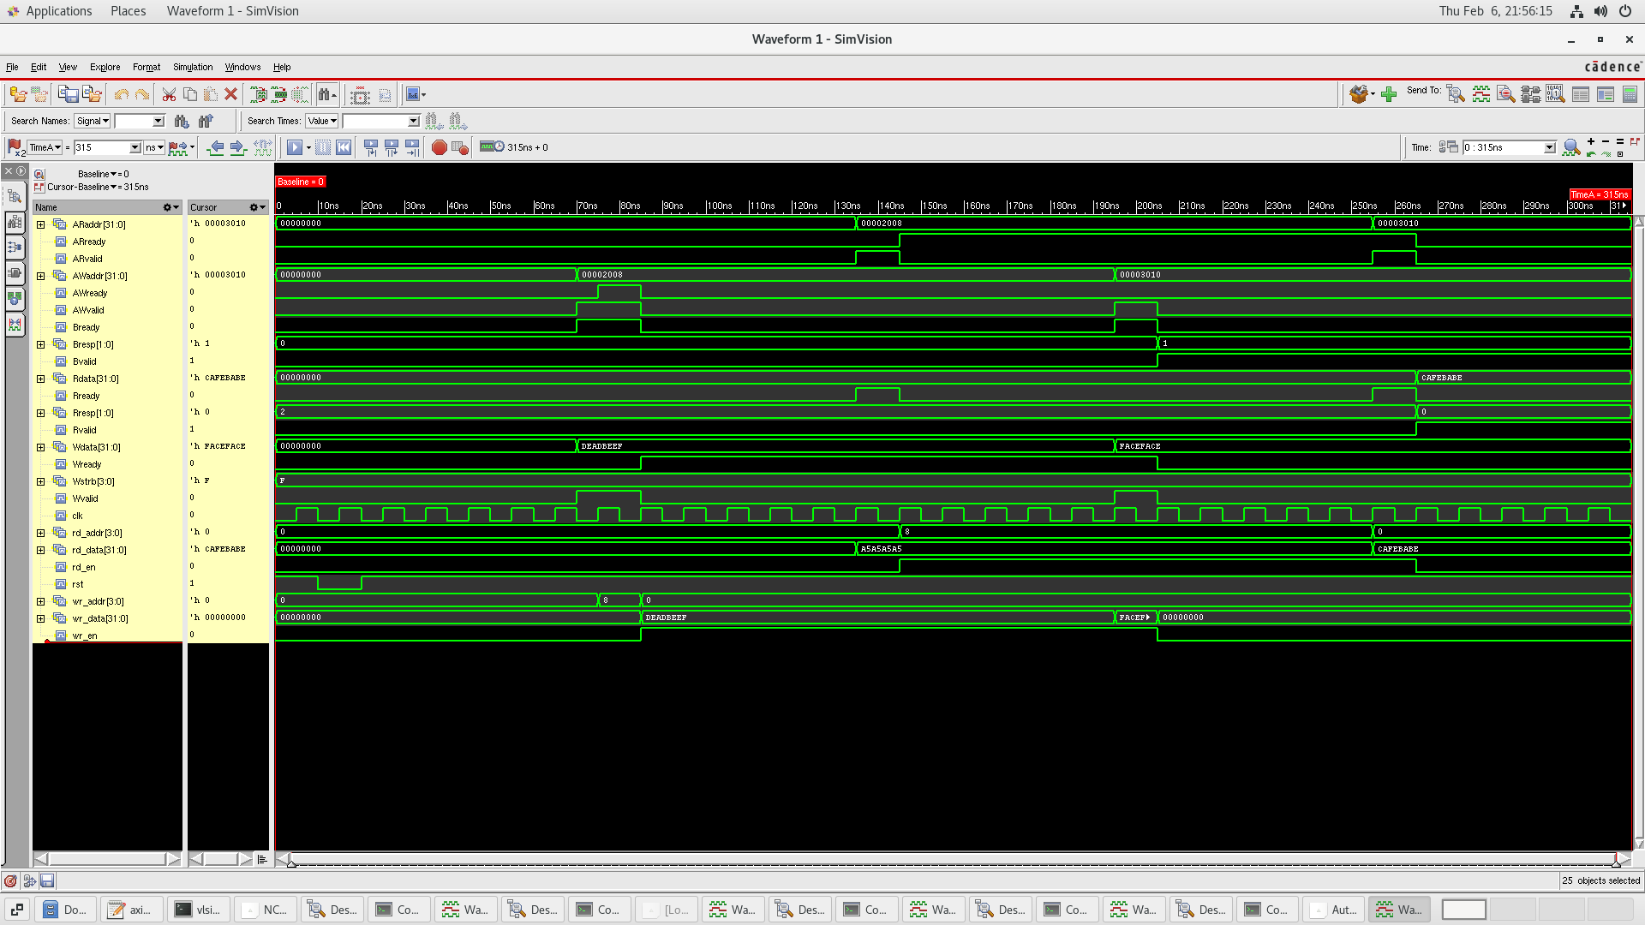

Slide 21
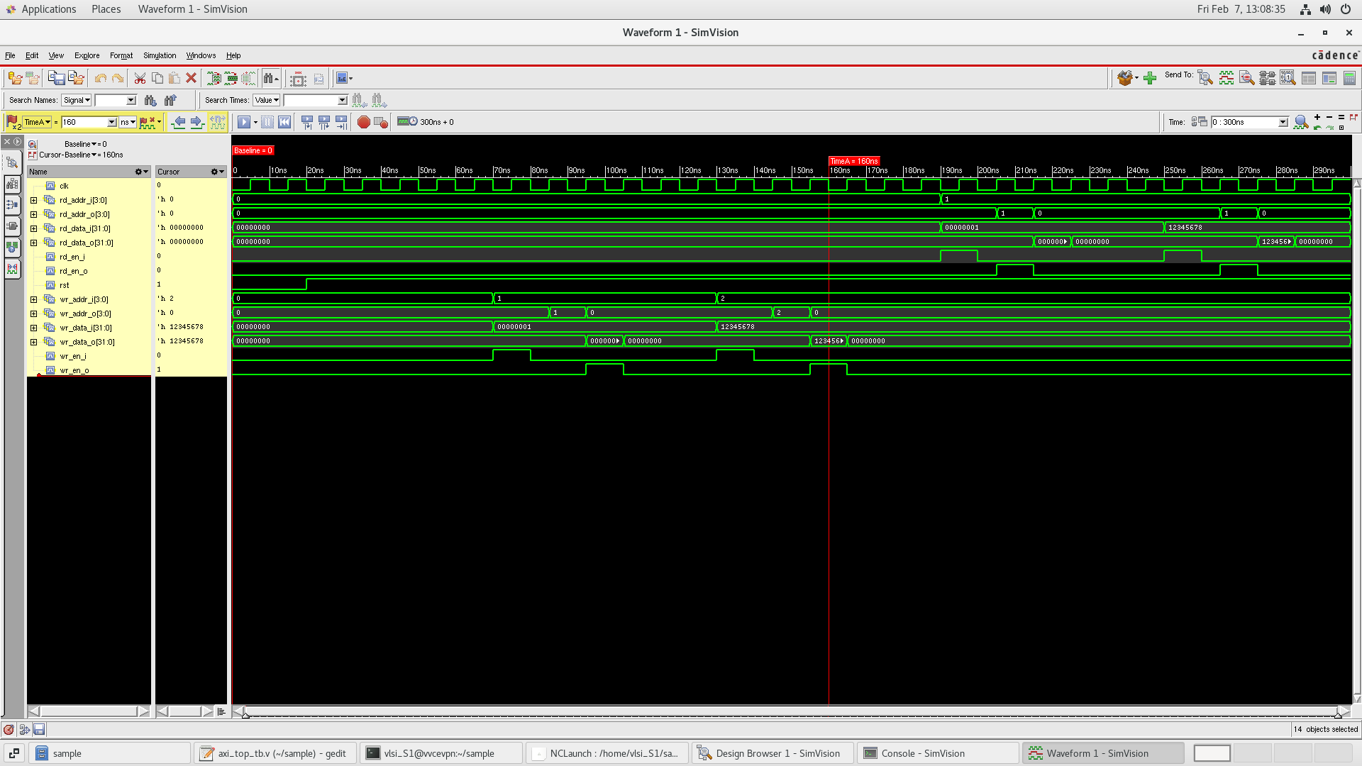

Slide 22
Outcomes of Internship
Strong Understanding of ASIC Design Flow.
Knowledge of On-Chip and Peripheral Protocols.
Gained knowledge of the complete process from RTL design to GDS.
Learned how to design and optimize an ALU for specific processor requirements.

Slide 23
Conclusion
Working as an intern in the company provided various benefits and they are as follows:
The VLSI Internship provided me with practical knowledge of the ASIC Design Flow, including RTL Design, Verification, Synthesis, and Timing Analysis.
I gained hands-on experience with On-Chip and Peripheral Protocols, enhancing my understanding of SoC communication.
This internship significantly strengthened my technical skills in VLSI Design, preparing me to contribute effectively to the semiconductor industry.

Slide 24
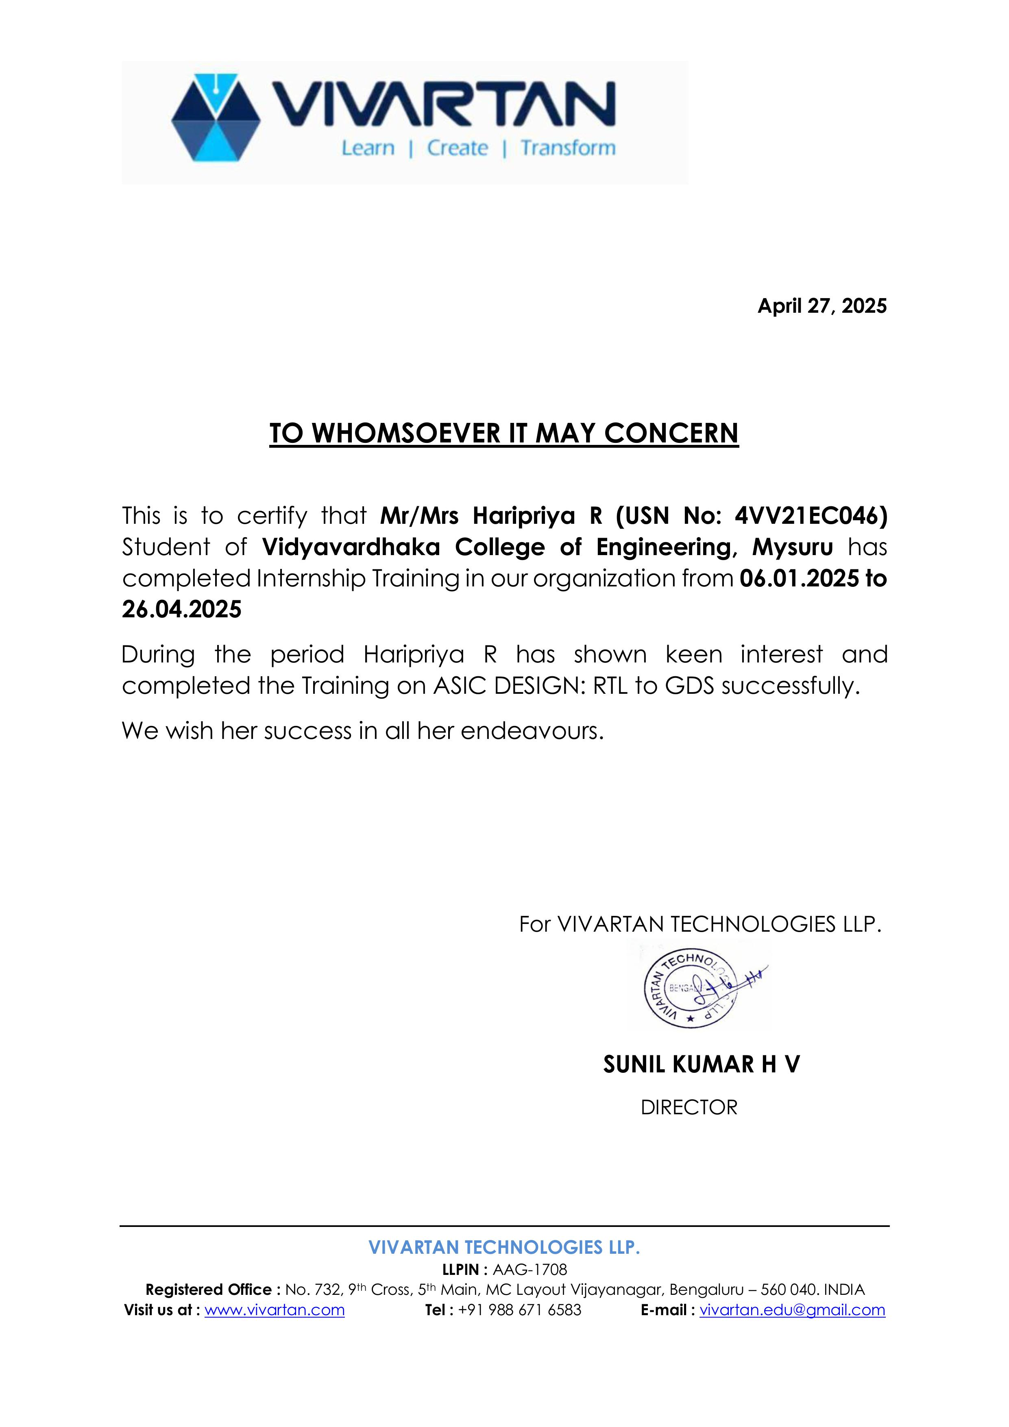
Internship Certificate

Slide 25


